Slide 1



Course Introduction
#getyourheadaroundcode @lpoolgirlgeeks

Slide 2
Sitemap
index.html
Homepage
contact-us.html
Contact Us
#getyourheadaroundcode @lpoolgirlgeeks

Slide 3

Course Objectives
homepage
#getyourheadaroundcode @lpoolgirlgeeks

Slide 4
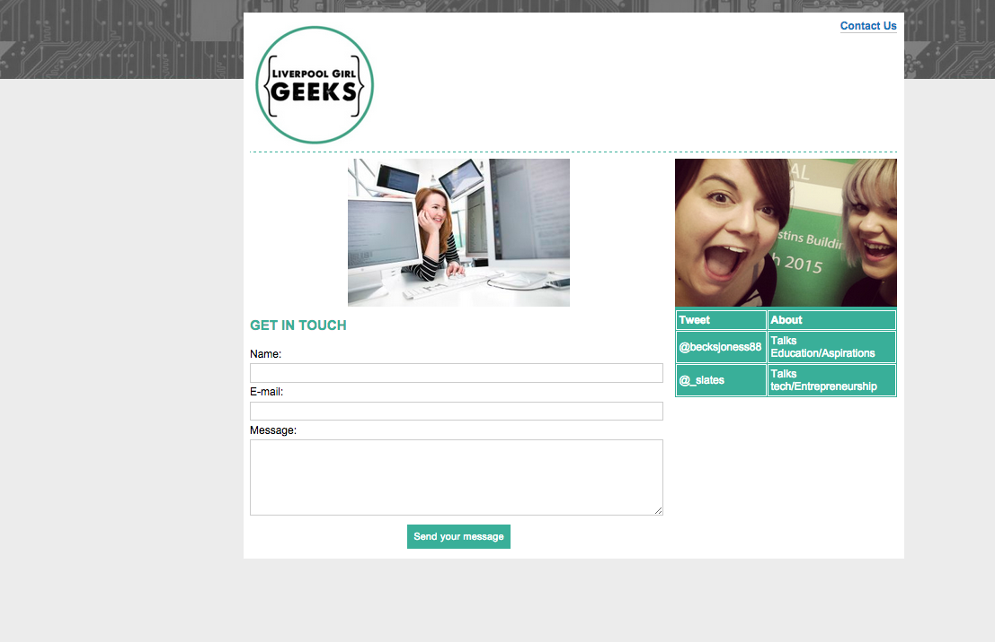
Course Objectives
Contact Us page
#getyourheadaroundcode @lpoolgirlgeeks

